Slide 1
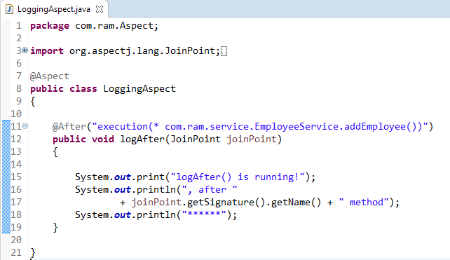
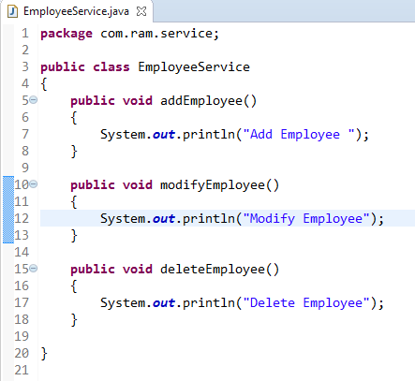
AspectJ @After
@After declares the after advice. it is executed after the actual method call. If method returns a value, it is executed after returning value.
method
AspectJ “pointcuts” is used to declare which method is going to intercept
@After
2
1

Slide 2
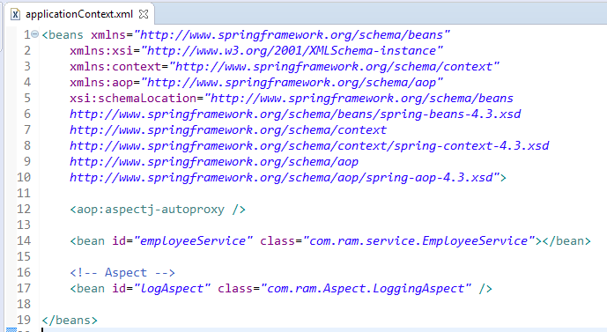
To Enable AspectJ, In Spring configuration file, put “<aop:aspectj-autoproxy />“, and define your Aspect (interceptor) and normal bean

Slide 3
